Slide 1
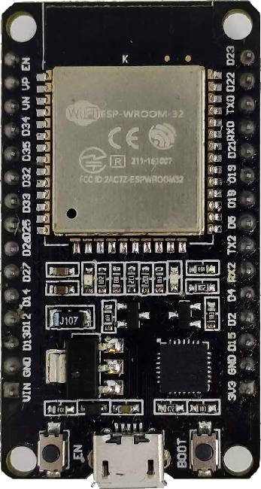
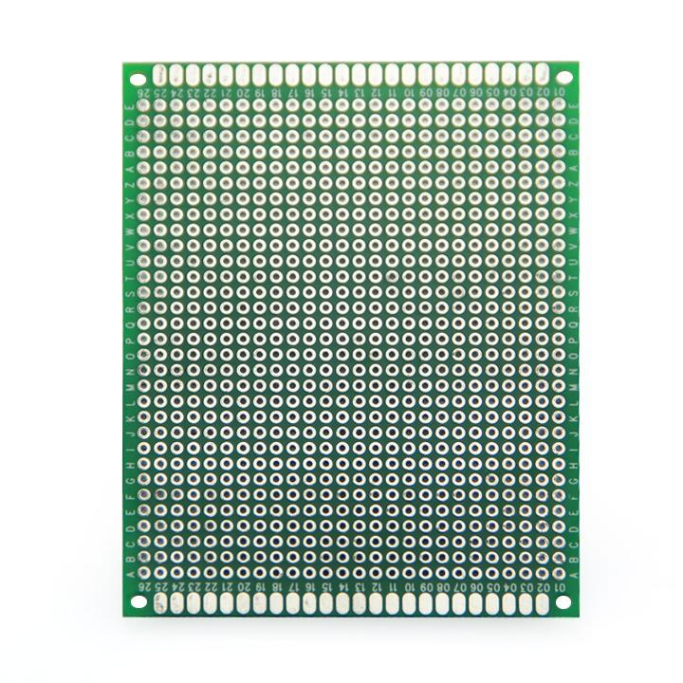
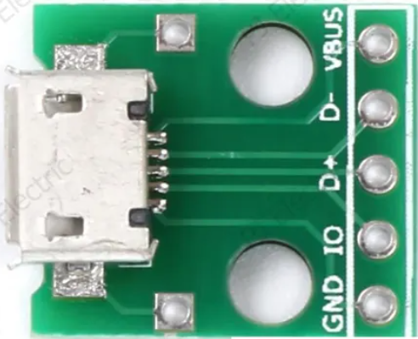
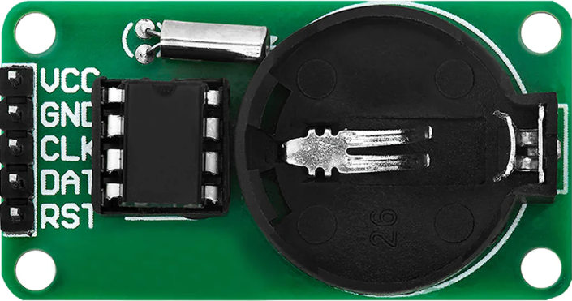
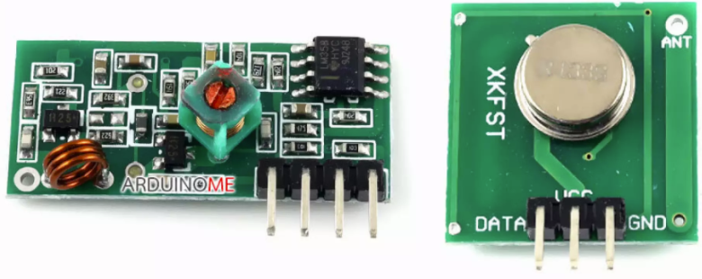
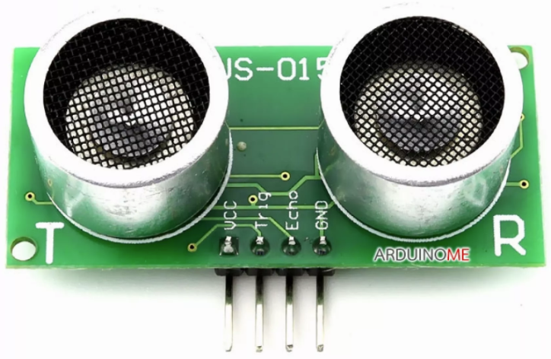
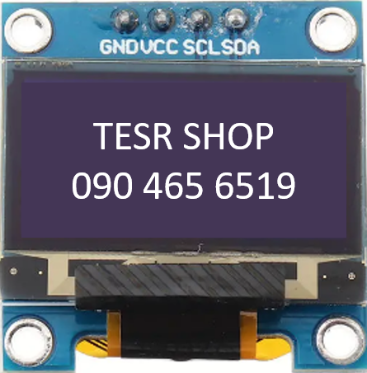

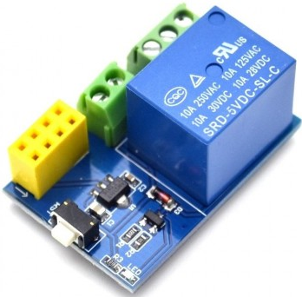
RTC Clock DS1302
VCC
GND
CLK
DAT
RST
Public Klong Sensor
RF 433Mhz
VCC33-DAT/DAT-GND
Ultrasonic Meter Sensors
GND-TRIG(19)-ECHO(34)-VCC5V
#BKO-DMZ-DEV1 v1.00
BKO-GARDEN-DMZ-DEV1
192.168.4.1 (AP)
South Kl. Public Kl.
-23.73cm -46.81cm
Pump:Ready Mode:AUTO
All Set! 254 min
RF 433Mhz
ENT-DAT-VCC33-GND
I2C Channel extensions
GND-VCC33-CLK-DTA
DEBUG CHANNEL
GND-RX-TX
OUTPUT RELAYS CONTROL
GND-TRIG-VCC5V
South Klong Sensor
Public Klong
Pump
Menu / Mode
- / Action A
+ / Action B
Confirm / Cancel
D26
D15
D26
D18
South Klong
Pump

Slide 2
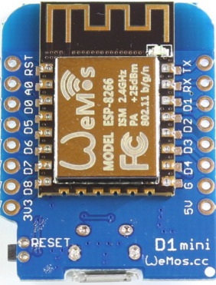
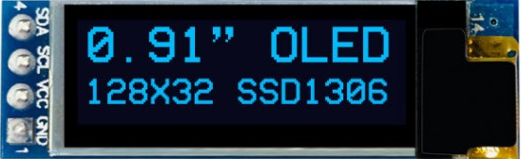
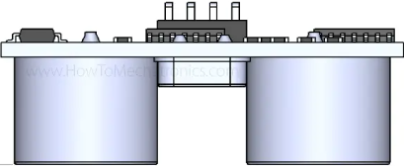
5V
GND

Slide 3
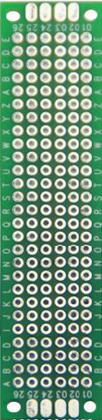

Slide 4
